Slide 1

SRO Data Lake
ERSAP Data Lake Implementation
Vardan Gyurjyan JLAB EPSCI Group

Slide 2

SRO Primary Goal
Accept data with minimal loses
Minimize SRO dead time
Give more time for backend (services down the stream) to process data
Stream-strike functionality: similar to signal delay cables during the triggered readout system
Data-Lake as a design choice for the stream-strike functionality
Temporary in-memory data storage with possible persistency in case of backend dyskinesia
Centralized storage of unprocessed frames from all streams
Ideal for ML applications

Slide 3
ERSAP Data Lake
Low latency, in-memory storage for structured stream-frames
Elastically scalable
Point-in-time persistency of in-memory stream-frames
Contains stream-frames missed by the back-end
User defined horizontal scaling threshold
Tolerable back-end slowness after which
Persisted data replication on a different node
”delayed” parallel processing of data-frames
Pilot implementation based on Redis
In memory NoSQL database
Open source
Large user/support community

Slide 4


Data Lake Scaling
C reads and removes the stream-frame
Data-lake grows if C can not keep up with P
Persistent snapshots of the data-lake
Horizontal scaling of the data-lake in case C vertical scaling in not sufficient
P
C
Replication
C’
Contains stream-frames
not processed by C
Contains stream-frames
not processed by C’

Slide 5
CLARA Data Lake Services
Clara data-lake IO services
Raw frame read/write
Clara StreamReceiver service
Frame header parsing
Frame payload storage, hashed by the frame-time for easy processing
Clara StreamConsumer service
Consumes raw frames or farm payloads of multiple streams

Slide 6
Rapid Prototyping
Event-rate = 10KHz
Data-rate = 800MByte/sec
Lossless data throughput
(in and out data-lake)
9.6 GByte/sec
Stream Source
Software
1
StreamReceiver
1
StreamConsumer
1
ERSAP
Data Lake
-----
-----
Stream Source
Software
12
StreamReceiver
12
StreamConsumer
12
Multi-threaded write
Multi-threaded read
VTP simulated Data Frame
800MByte/sec max frame size per VTP link.
65us window, 8 FADC per 10Gbps link, maximum 1 hit reported per 32ns, 4 bytes per hit:
13 (Header) + (1+65536/32)*8 = 18454 32bit words => 73816bytes

Slide 7
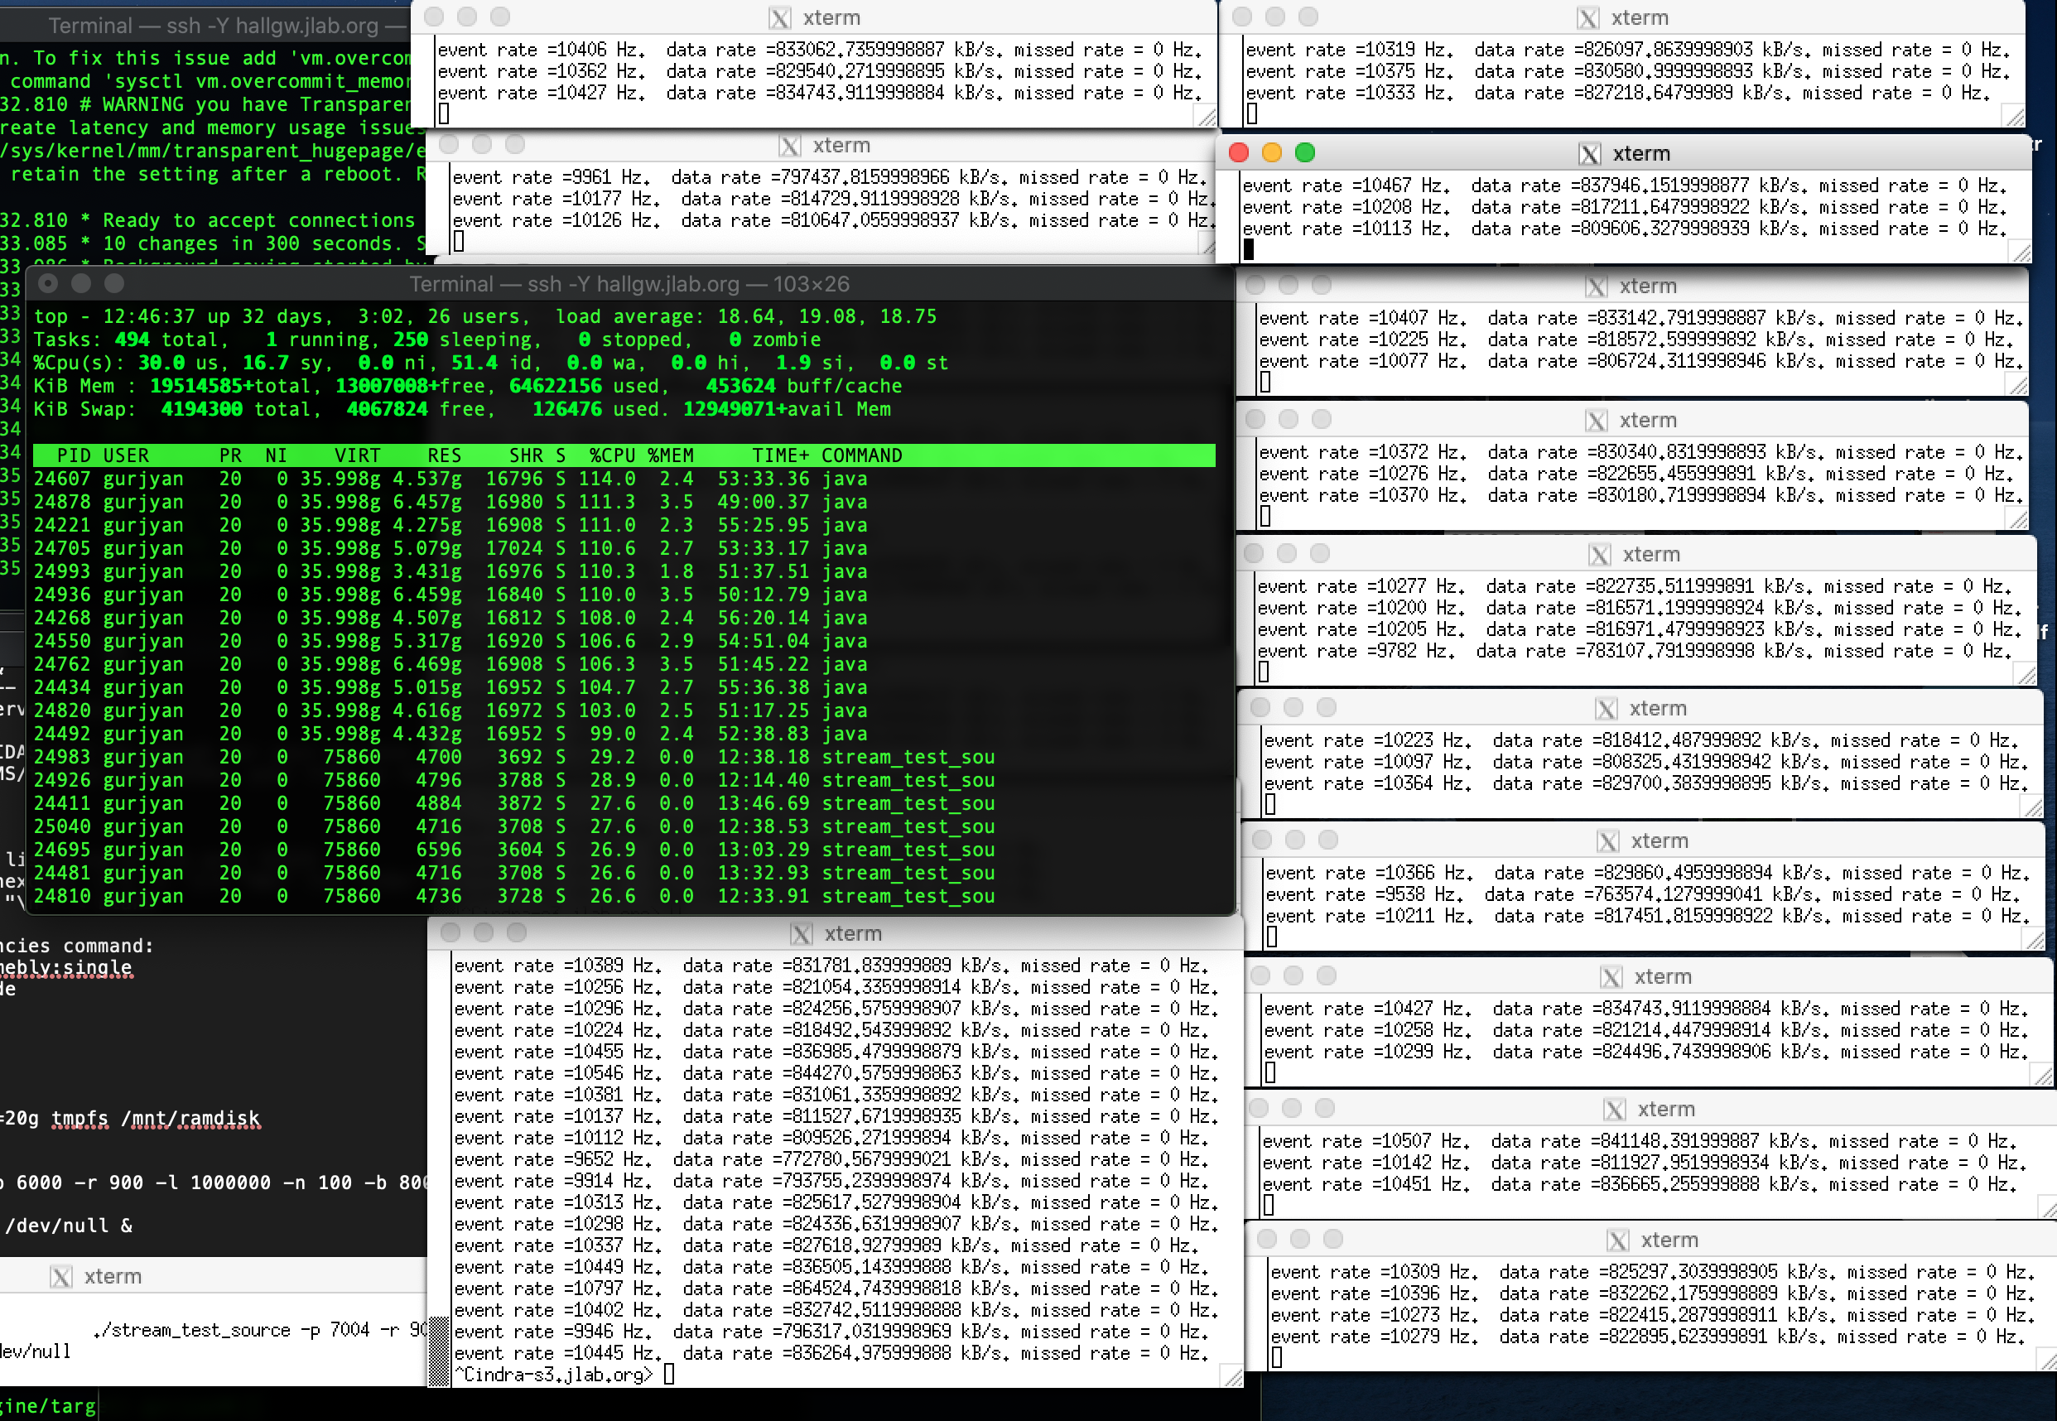
Screen Shot

Slide 8
Summary
Developed and benchmarked ERSAP data-lake prototype.
Demonstrated ~10GByte/sec lossless data throughput in and out of the data-lake.
Work in progress
Thank you

